Slide 1
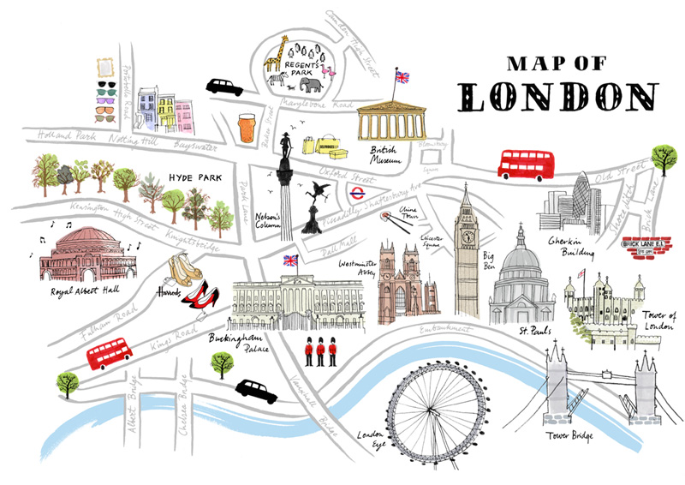
James Walters
Georgraphy

Slide 2
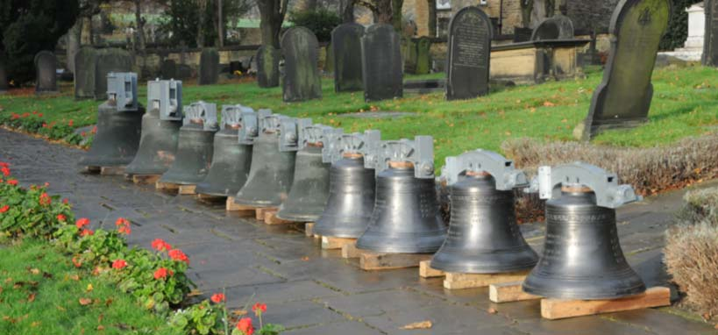
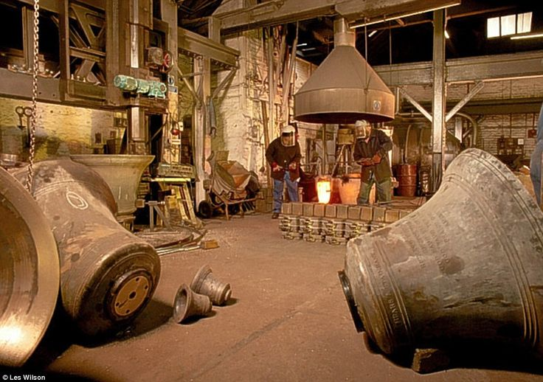
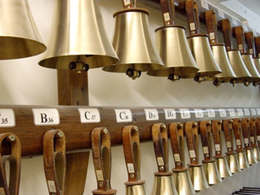
Whitechapel Bell Foundry Maker of tower bells and handbells. The oldest bell foundry in the world.

Slide 3
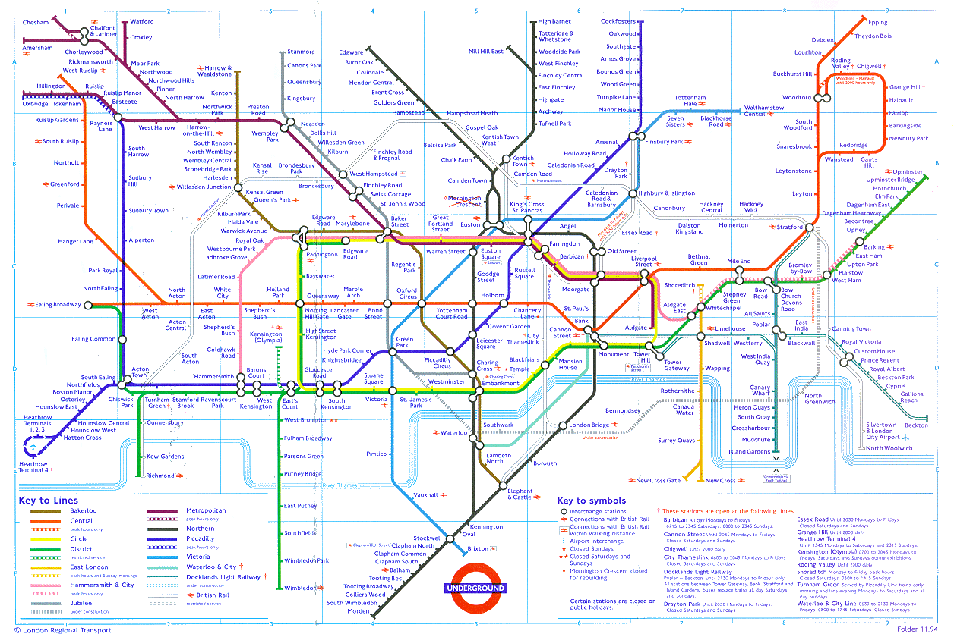
Whitechapel Bell Foundry
Located in Whitechapel

Slide 4
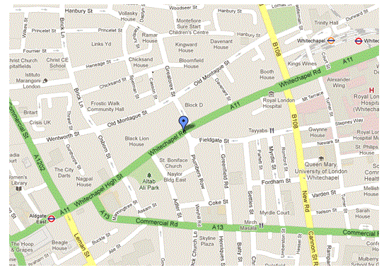
Take the Green Line east from Victoria Station. Exit at Aldgate or Whitechapel.

Slide 5
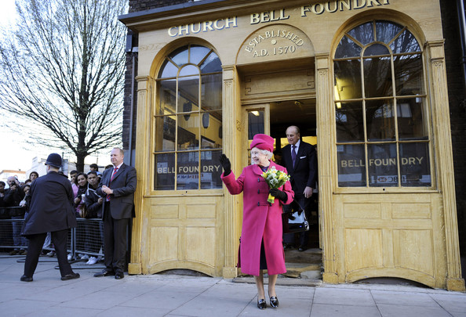
Queen Elizabeth visits.

Slide 6
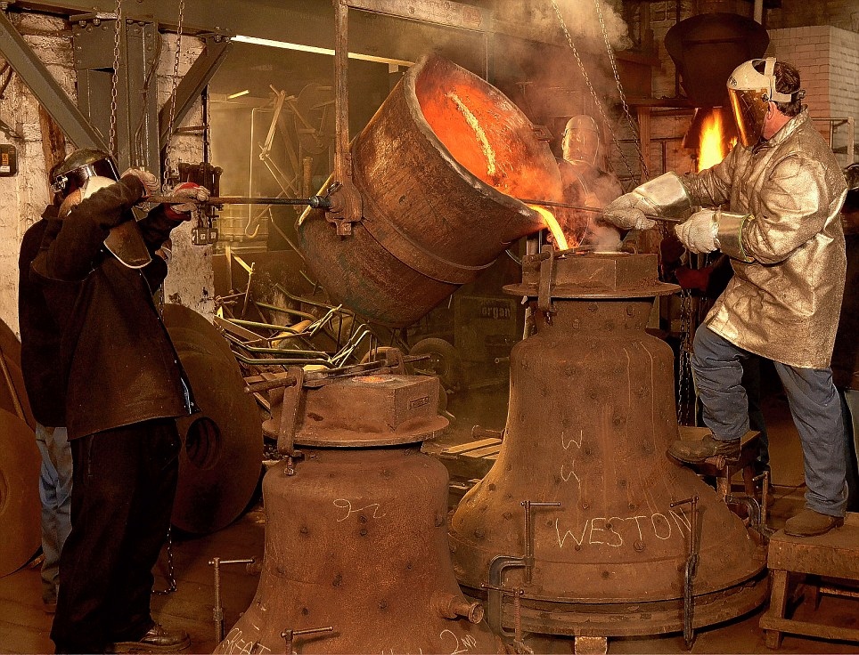
Take the tour.
These are tower bells being cast.

Slide 7
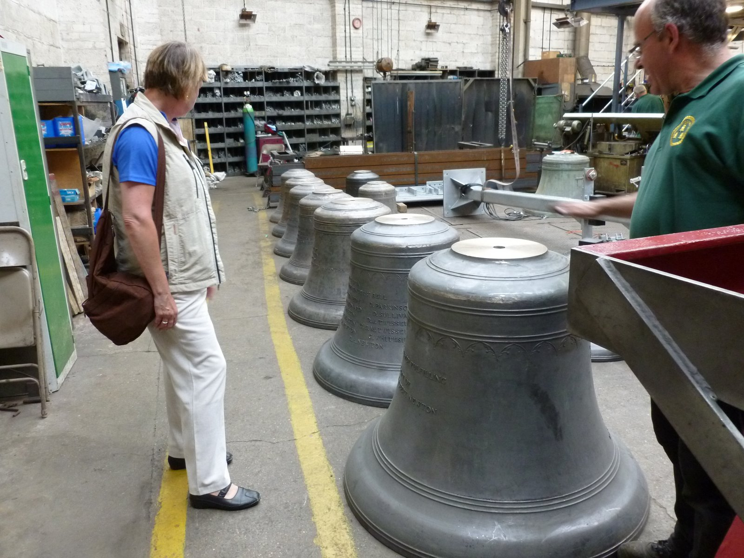
New tower bells before polishing

Slide 8
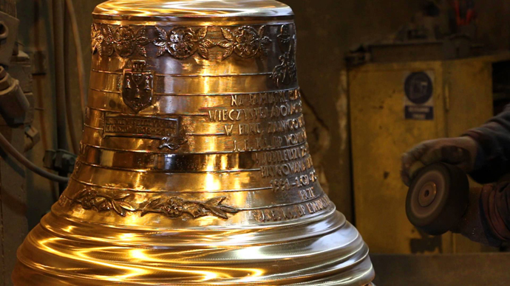
After polishing and inscribing

Slide 9
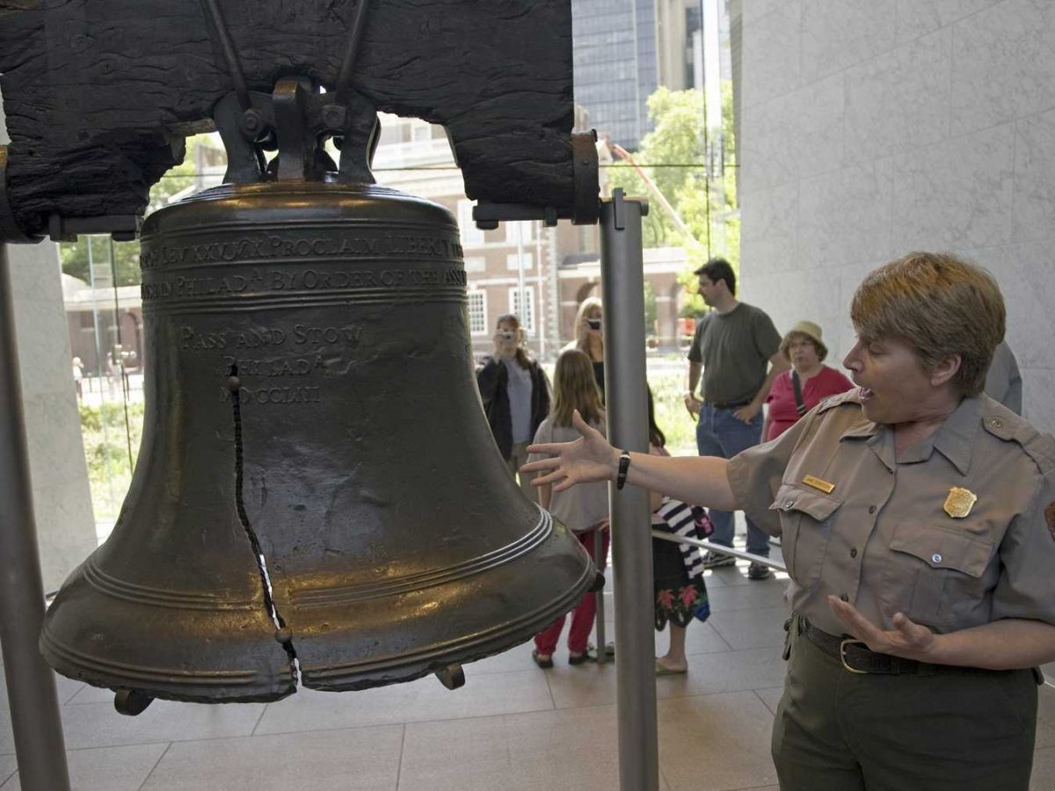
The Liberty Bell in Philadelphia was made by Whitechapel.

Slide 10
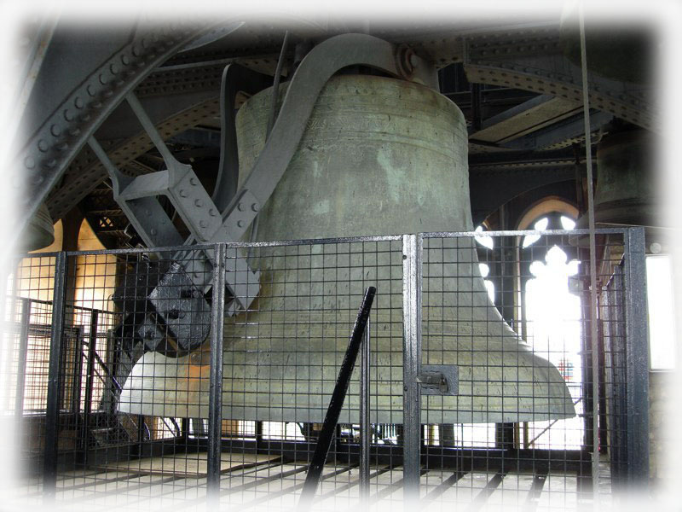
Big Ben
The largest bell ever cast by Whitechapel is located in Elizabeth Tower.

Slide 11
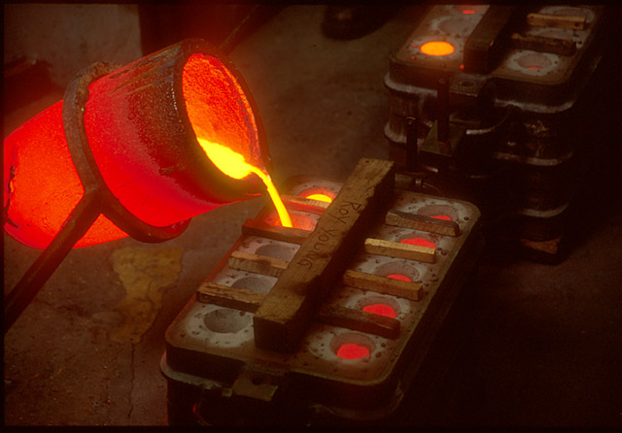
Handbells being cast

Slide 12
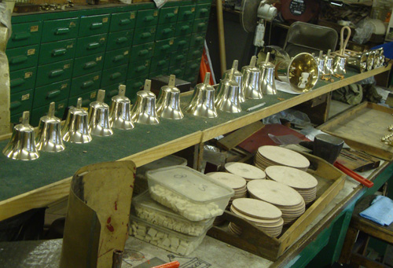
Handbells after their first polishing

Slide 13
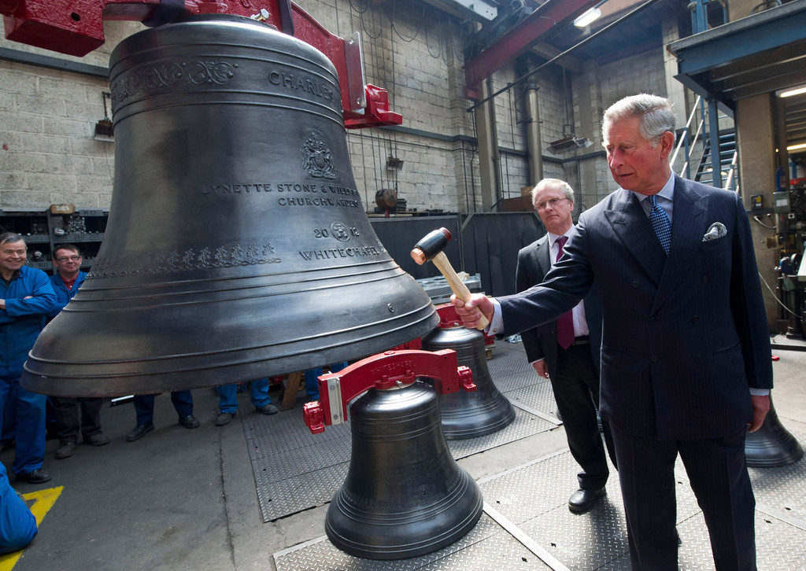
Prince Charles strikes a new bell.

Slide 14
History
Whitechapel has been making bells since at least 1570. The first handbells rung in the United States by the Lancashire Ringers in 1844 were made by them.
Foundry Store and Museum
These are open Monday through Friday, 9am to 4pm.
Decorative bells, door bells and dinner bells of various sizes may be purchased, as well as gloves, mallets and other accessories for handbell musicians. Handbell sets may also be ordered.
No food is available. There are cafes and restaurants close by the shop.
Tours
Tours are available on Saturdays. They must be booked in advance. The cost is £15 per person. Tours last 90 minutes and are limited to 25 people per tour.

Slide 15
Contact Information
Phone 020 7247 2599
Fax 020 7375 1979
Email bells@whitechapelbellfoundry.co.uk
32/34 Whitechapel Road
London
E1 1DY

Slide 16
Whitechapel has books listing all the handbells they have sold for the past couple of centuries. I would like to look through these as part of the research I am doing for a book about the history of handbells in America.

Slide 17
the end

