Slide 2
Johann Sebastian Bach

Slide 3
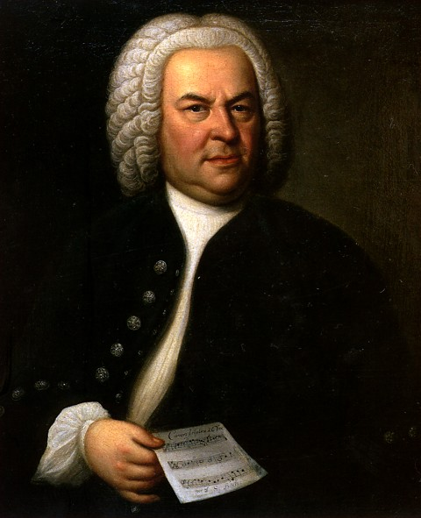
Johann Sebastian Bach
A Life in Germany
James Walters
September 2015

Slide 4
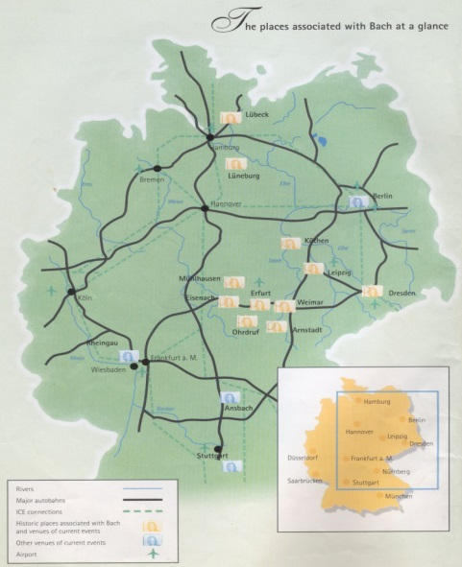
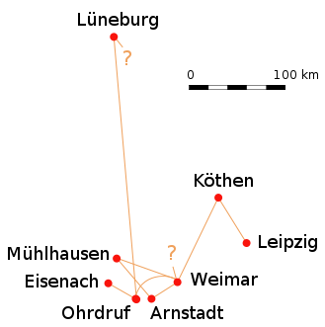
Bach was employed as music director and organist in towns throughout central and eastern Germany. He never left this small area of Europe in the sixty-five years of his life.
Johann Sebastian Bach
A Life in Germany

Slide 5
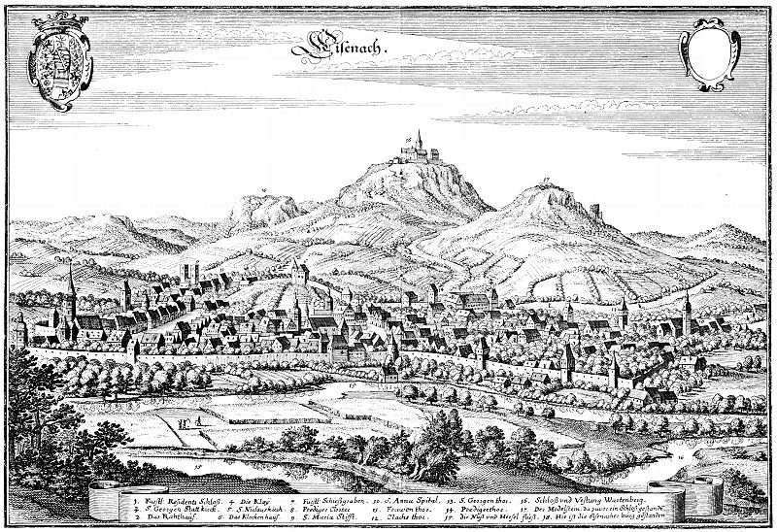
Johann Sebastian Bach
Early Life
Johann Sebastian Bach was born in Eisenach, in what is now central Germany, on 31 March 1685. His father was the town’s music director and all of his uncles were professional musicians. Bach studied music with many of them. Among the instruments he played were the organ, harpsichord, violin and viola.
Bach left home at the age of ten, after his parents died. He lived in Ohrdruf, with his older brother, where he studied the scores of some of Europe’s most popular composers. At age fourteen he won a scholarship to study music in Lüneburg for four years.

Slide 6
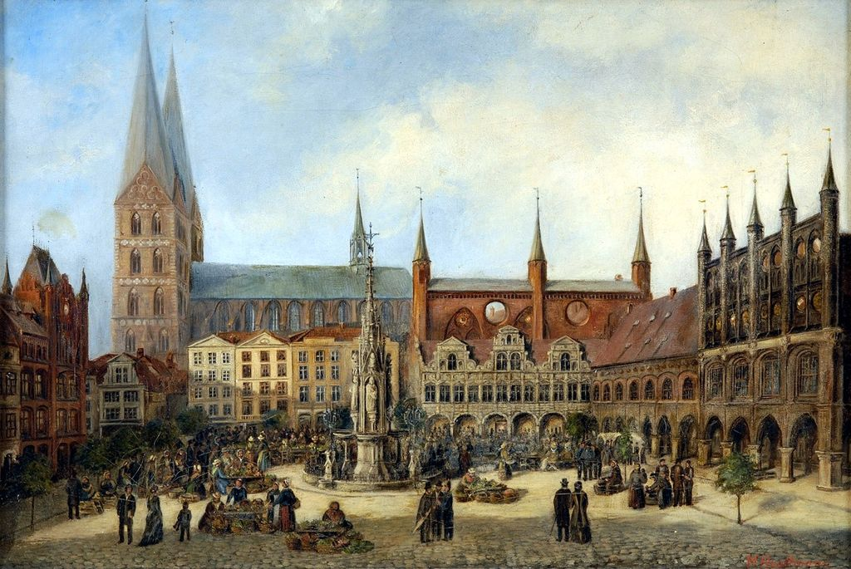
Johann Sebastian Bach
Trip to Lübeck
In 1705, Bach wanted to meet and hear the great organist and composer Dieterich Buxtehude. Because there was no
recording technology at the
time, people had to travel to
hear musicians or the musicians
had to come to them. Bach had
to walk 280 miles each way and
was gone for several months. * His employer was not happy with him when he returned home in 1706.
*If you walked 280 miles from
Redlands, where might you end up?

Slide 7
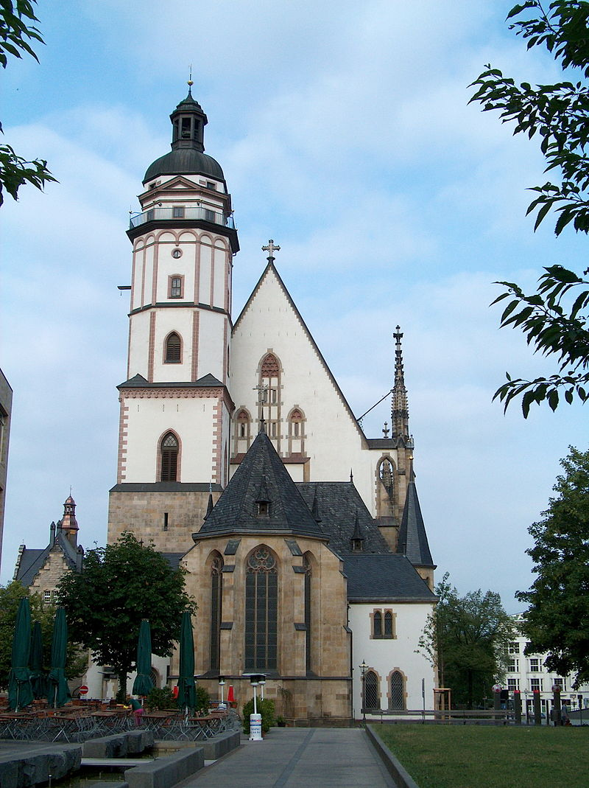
Johann Sebastian Bach
Leipzig
Bach spent the last twenty-seven years of his life in Leipzig. He directed the music at four churches and was in charge of music for official city events. In addition, he taught singing and Latin to the boys of the Thomasschule. This school was operated by the main church in town, the Thomaskirche.
He composed new music for services there, directed the choir and instrumentalists and played the organ. Most of his cantatas were composed in Leipzig during his first three years there.

Slide 8
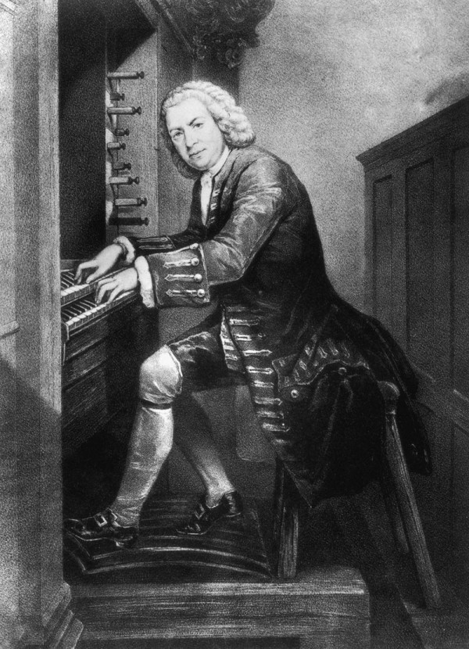
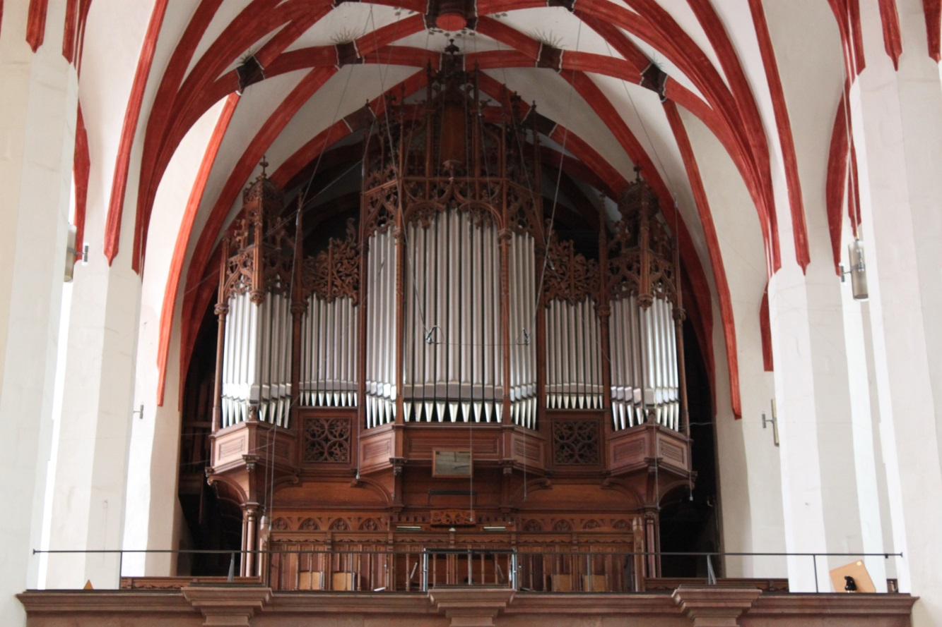
Johann Sebastian Bach
Leipzig
Bach played this organ in the Thomaskirche. I enjoyed hearing an organ concert there in the summer of 1992. Sitting in the church where Bach spent so much of his life, listening to his music being performed on the organ he played, was an unforgettable experience.

Slide 9
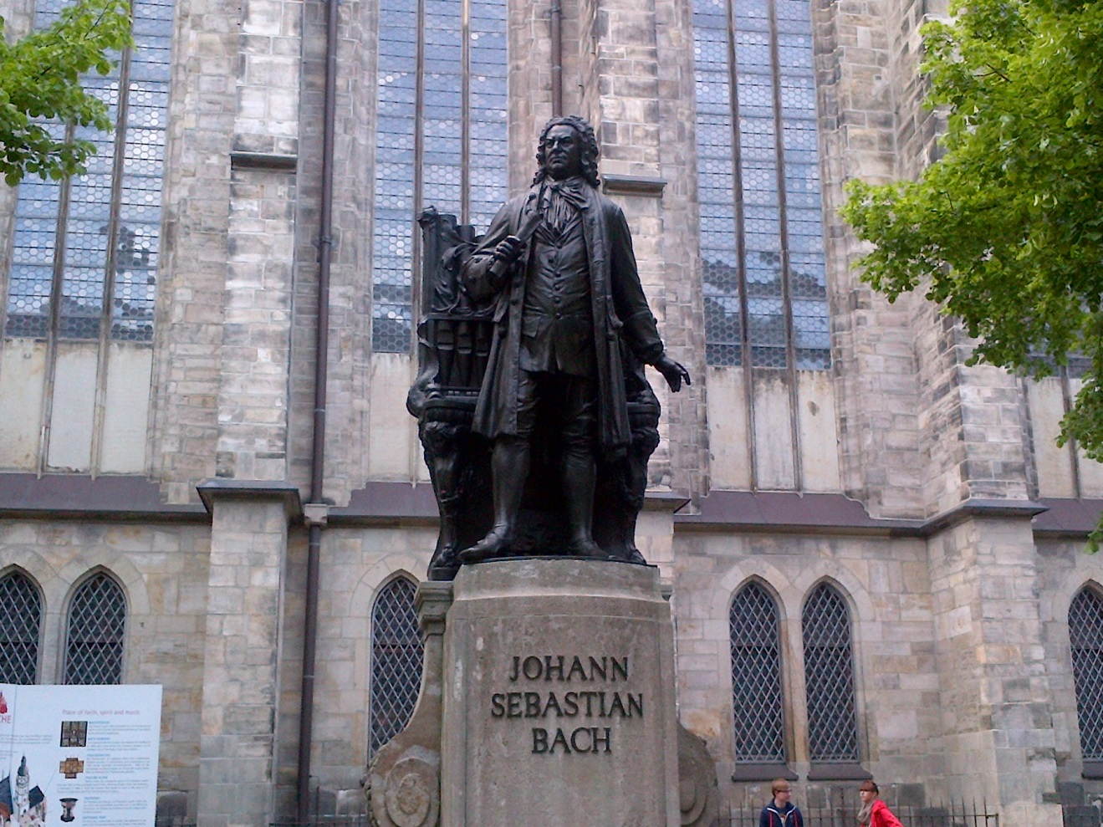
Johann Sebastian Bach
Thomaskirche, Leipzig
Bach spent the last twenty-seven years of his life in Leipzig. He directed the music at four churches and was in charge of music for official city events. In addition, he taught singing and Latin to the boys of the Thomasschule. This school was operated by the main church in town, the Thomaskirche.
He composed new music for services there, directed the choir and instrumentalists and played the organ. Most of his cantatas were composed in Leipzig during his first three years there.
1685-1750

Slide 10
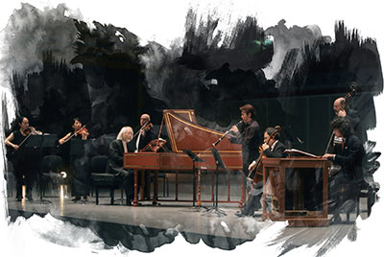
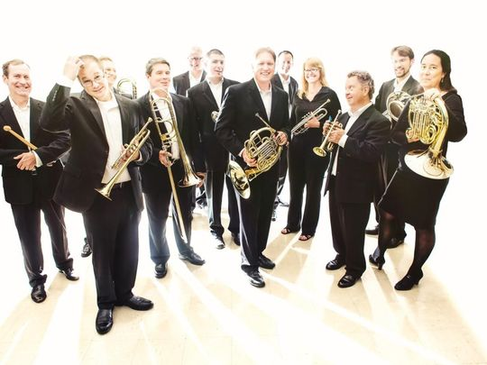
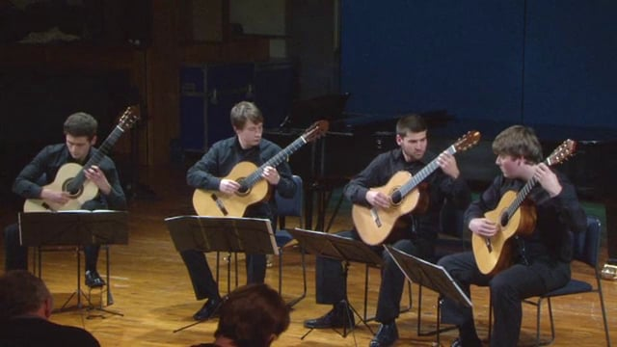
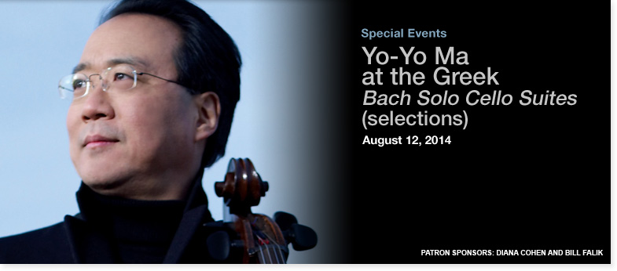
Johann Sebastian Bach
Legacy
Though Bach never left Germany, his music is performed throughout the world every day of the year. In fact, there is probably no musician of any time whose music has touched so many people, even more than 250 years after his death.

Slide 11
the end

